Slide 1






Robust Ellipsoid-specific Fitting via
Expectation Maximization
Mingyang Zhao^{1,2} Xiaohong Jia³ Lei Ma^{1,4}
Xinling Qiu⁵ Xin Jiang⁶ Dong-Ming Yan²

Slide 2
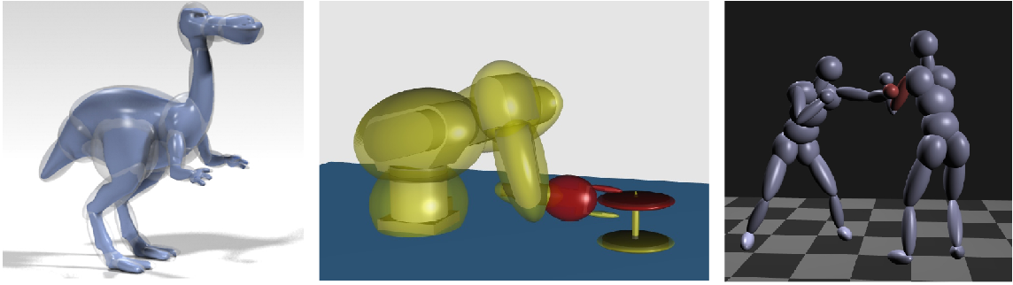
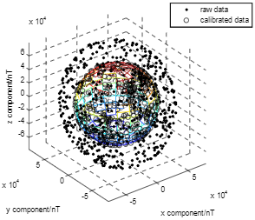
Applications — Ellipsoid Fitting
[Lu et al. 2007]
[Choi et al. 2009]
[Choi et al. 2009]
[Chi et al. 2018]

Slide 3
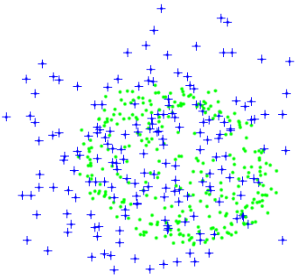
Definition — Ellipsoid Fitting
Our objective: Recognize the ellipsoid from noisy or outliers-contaminated data points
Quadrics

Slide 4


Traditional Methods
Algebra
Geometry
Easy to solve
VS.
More accurate
Sensitive to outliers
Sensitive to outliers

Slide 5
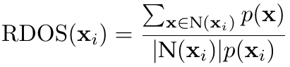
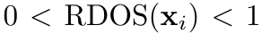
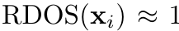
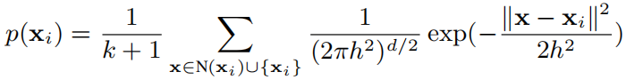
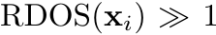
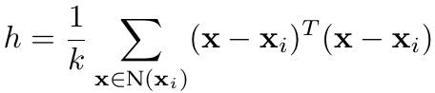
Our Method — Ellipsoid Fitting
Relative-density-based outlier score——RDOS
is not an outlier
is maybe an outlier

Slide 6
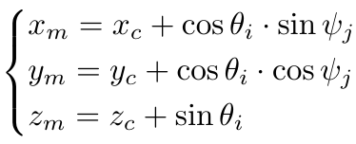
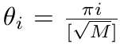
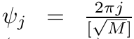
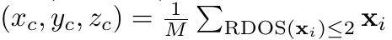
Our Method — Ellipsoid Fitting
Create an unit spherical surface based on RDOS

Slide 7
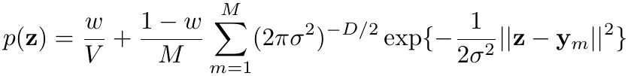
Our Method — Ellipsoid Fitting
Use maximization likelihood for parameter estimation
Model outliers by the
uniform distribution
Model the sphere by Gaussian
Mixture Models
Probability distribution+data points——>maximization likelihood estimation （MLE）

Slide 8
Our Method — Ellipsoid Fitting
Object: Minimize the negative log likelihood function

Slide 9
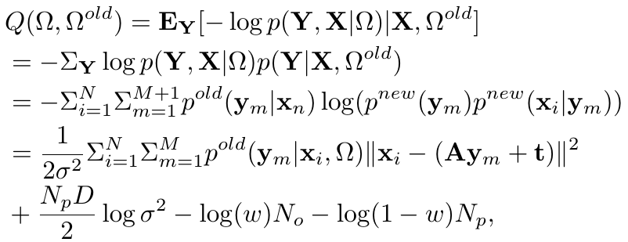
Our Method — Ellipsoid Fitting
Solve for parameters by Expectation Maximization
E
M
Use the Bayesian principle to update the posterior probability
Update parameters by minimizing

Slide 10
Our Method — Ellipsoid Fitting
Accelerate EM convergence by the vector epsilon algorithm
Theorem[1]：Suppose is the original sequence of EM, is the new sequence generated by the vector epsilon EM, then
[1] Mingfeng Wang, Masahiro Kuroda, Michio Sakakihara, and Zhi Geng. Acceleration of the em algorithm using the vector epsilon algorithm. Computational Statistics, 23 (3):469–486, 2008.

Slide 11
Experiments— Ellipsoid Fitting
Experimental Evaluation

Slide 12
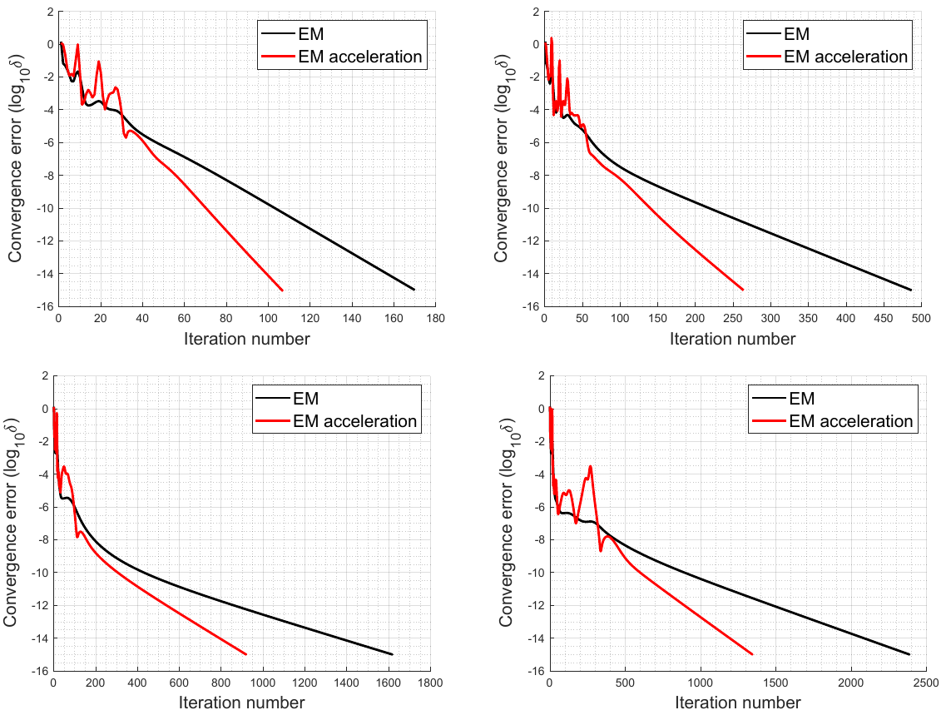
Experiments— EM Acceleration
200 points
500 points
800 points
1000 points
EM is much faster for more fitting points or with higher accuracy requirement

Slide 13
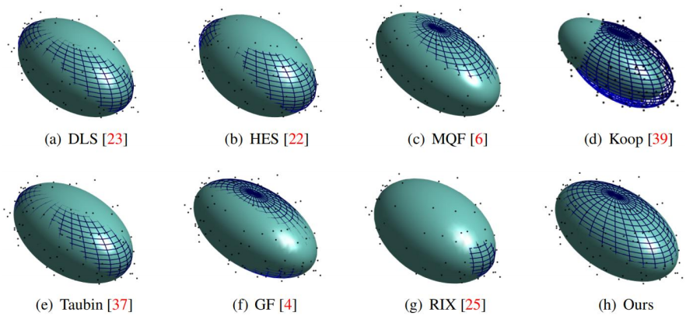
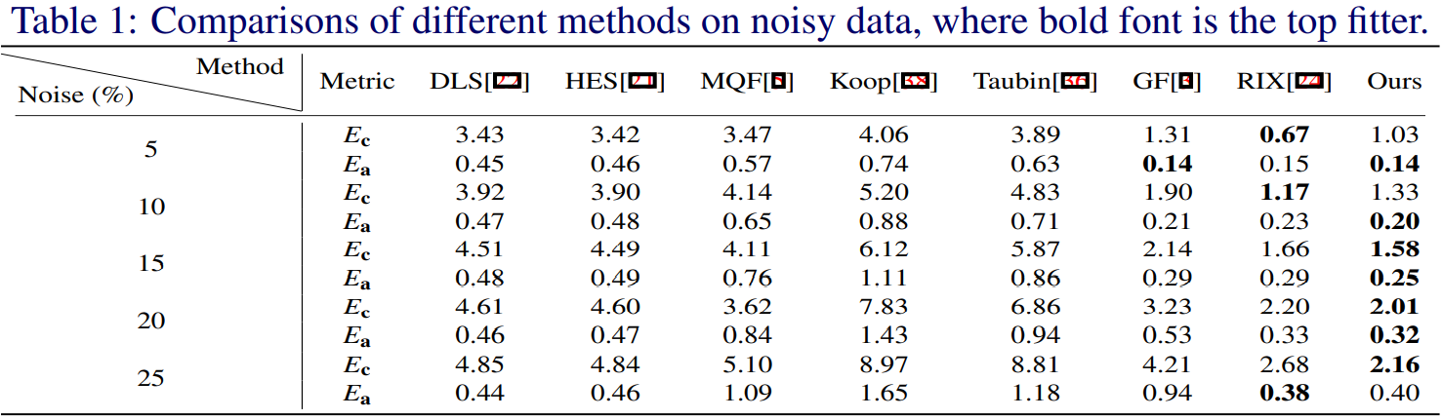
Experiments— robust against noise
Our method is more robust against noise

Slide 14
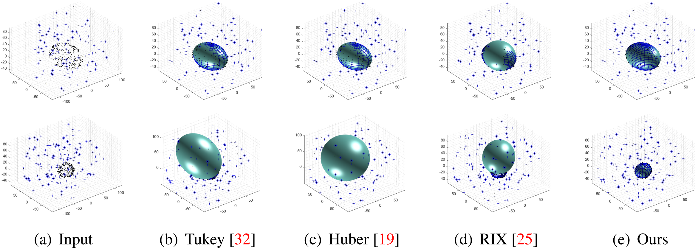
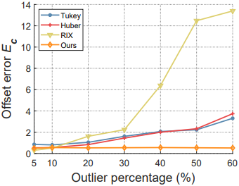
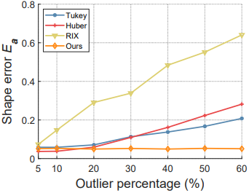
Experiments— robust against Outliers
Our method is more robust against outliers

Slide 15
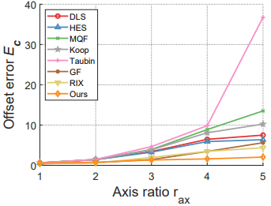
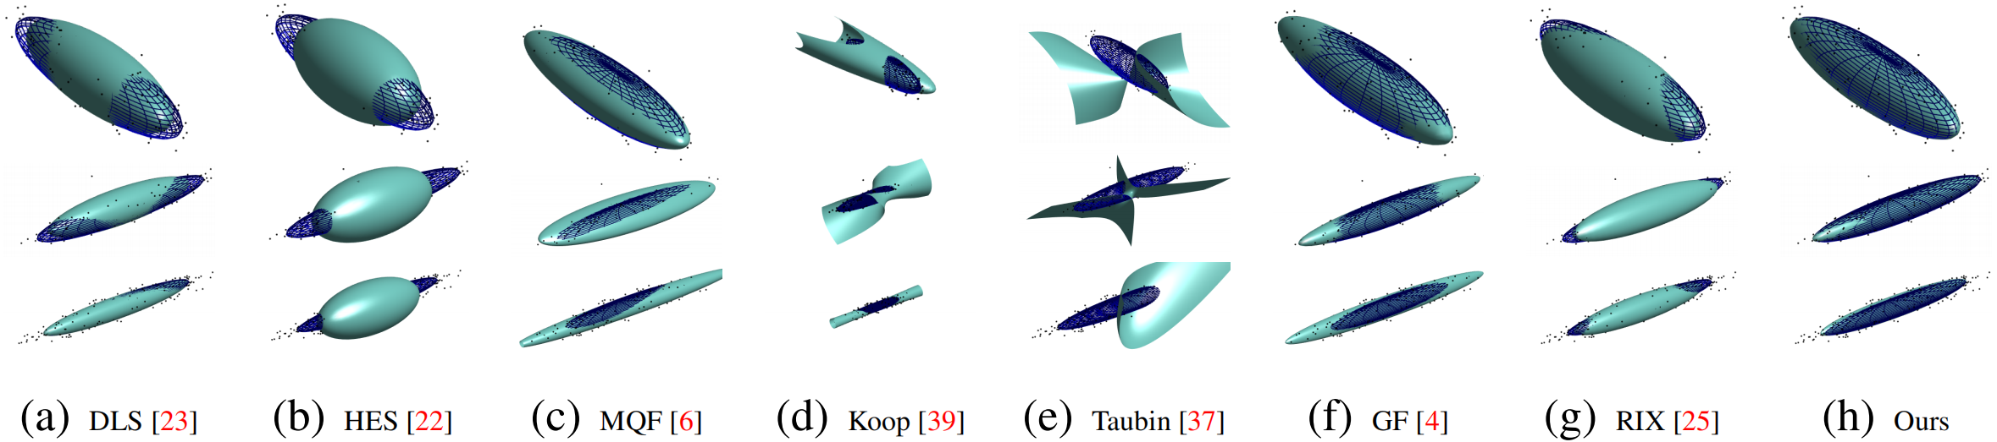
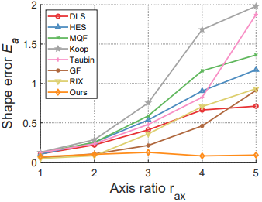
Experiments— robust against axis ratio
Our method is more robust against elongated ellipsoids

Slide 16
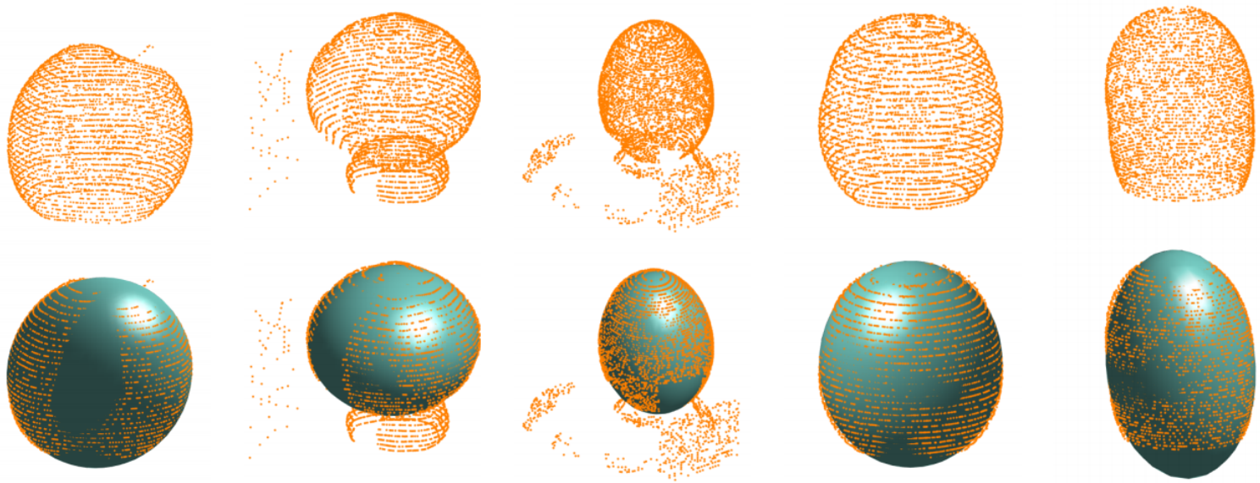
Experiments— Application for Point clouds
Application of our method for real-world point clouds

Slide 17
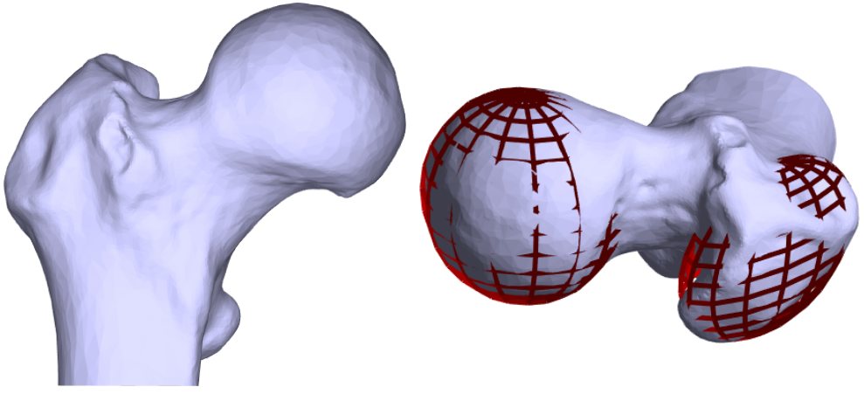
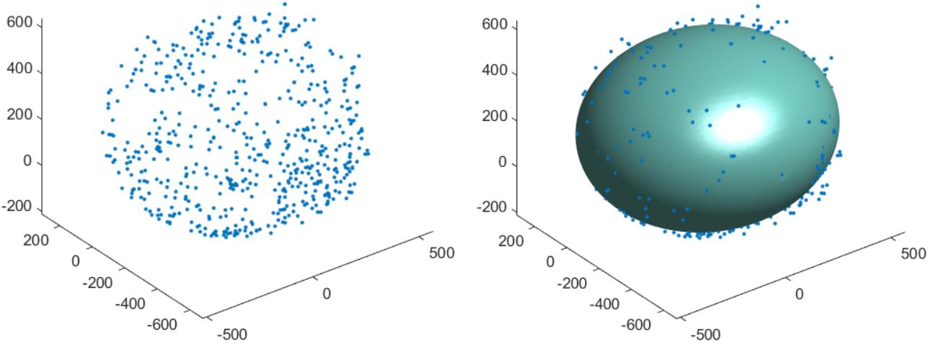
Experiments— Application
Application of our method for medical data and magnetometer calibration

Slide 18
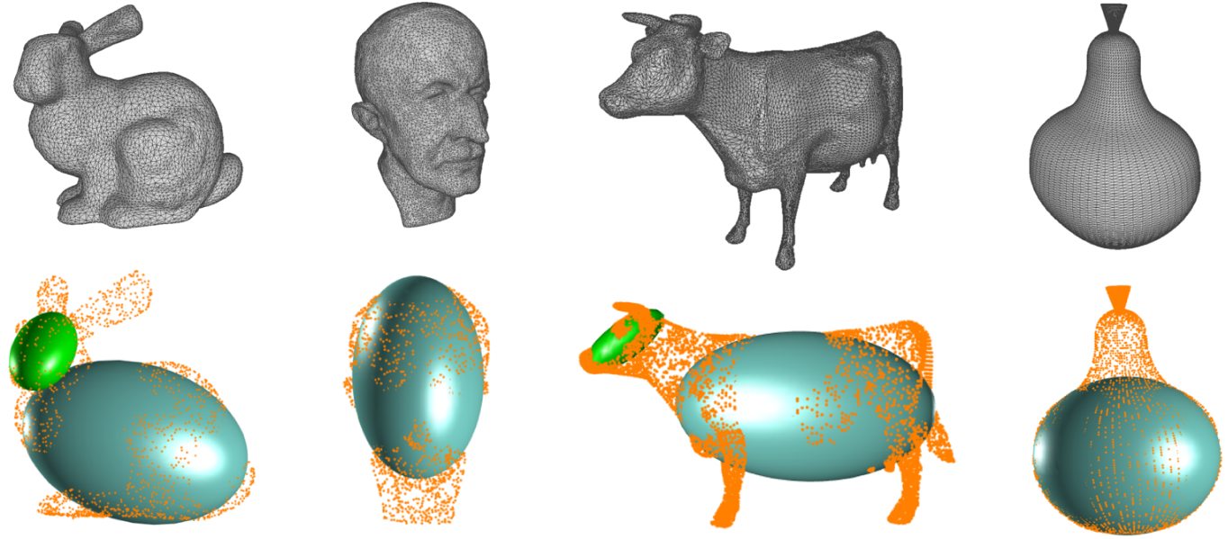
Experiments— Application
Application of our method for shape approximation

Slide 19
Thank you for your attention!
Thank the anonymous reviewers for their valuable comments
Paper link: https://arxiv.org/abs/2110.13337
Code: https://zikai1.github.io/EllipsoidFit.

